Slide 1
x The hard x (uvular fricative)
Notes:
This video will help you to learn to make and describe the hard x sound,

Slide 2
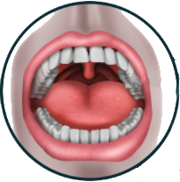
Uvula
Dangles at the back
Notes:
The hard sound, in Halq’emeylem is made at the UVULA, which is the fleshy lump that dangles down at back of your throat. Seen from the front the uvula looks like THIS.

Slide 3
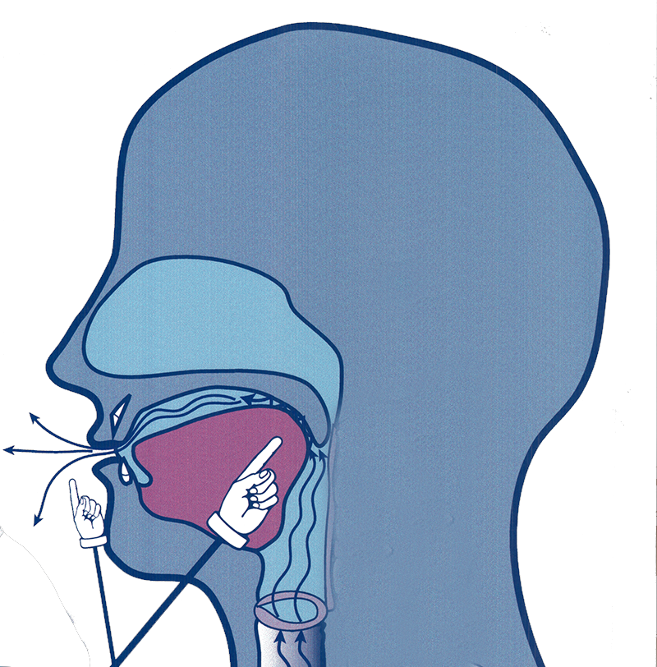
The hard x
Raise the back of your tongue to the uvula, create friction
Notes:
To make the Halq’emeylem hard-x sound, you pull the back of your tongue up so it is almost touching the uvula. This creates a friction-like noise as the air flows through.

Slide 4
Example with Elder
xìxà:m
Notes:
Here is an example of the Elder Siyamiateliyot saying a word with this sound. This word means ‘sobbing’, and the hard x occurs in it twice.

Slide 5
Careful! x ≠ x
xìxà:m - sobbing
xixq’á:m – having the mouth open
Notes:
The hard x is very different from the soft x in terms of how it is made and how it sounds. The hard –x has the tongue much further back in the mouth, where-as the soft-x has the tongue more towards the palate at the roof of the mouth.

Slide 6
x is also different from sh and lh
xìxà:m
sobbing
shúkwe
sugar
lhoqw’et
to slap somone
Notes:
The hard x sounds very different from the sounds sh and lh, too, though all are continuous sounds with friction-life airflow.

Slide 7
Summarizing the hard-x
A continuous sound with friction
The body of your tongue touches right back to your uvula.
It is a different sound from sh, lh, and the soft x.
Notes:
[can just read the text, expand a bit, as you run through the fades]

Slide 8
Spelling in other languages
In hən̓q̓əmin̓əm̓ (Downriver) the same sound is written with a big curvy x like this: χ.
In Hul̓q̓umín̓um̓ (Island) this sound is written x (no underline)
In Sḵwx̱wú7mesh sníchim (Squamish language) it is written with an underlined-x, like in Halq’emeylem.
In the Linguists IPA symbols is is the same as in hən̓q̓əmin̓əm: /χ/.
Notes:
[can just read the text, expand a bit, as you run through the fades]

