Slide 1
lh the hissy l
Notes:
This video will help you to learn to make and describe the Halq’emeylem sound lh, and to distinguish it from the regular l, as well as from other sounds that might sound similar.

Slide 2
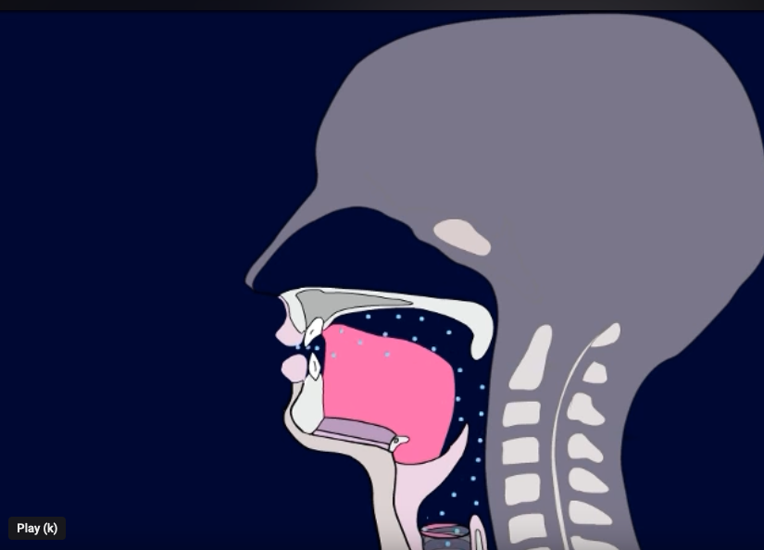
Regular l
Tongue touches RIDGE.
Air flows over SIDE(s)
Vocal cords VIBRATE.
Notes:
Let’s start by talking about the regular l, /lllllll/. When you make the regular /l/, THREE things happen. First, the tip of your tongue touches the ridge behind your teeth, what linguists call your ‘alveolar ridge’. Second, you let the air flow over one or both SIDES of your tongue. And third, your vocal cords are VIBRATING. This produces a sound with SMOOTH airflow. Try saying it yourself. /lllllll/ Can you feel your tongue touching your ridge? Now hold your finger gently to the front of your throat, and say it again. /llll/ Can you feel the VIBRATION in your throat?

Slide 3
lh (‘hissy l’)
Tongue is same (at ridge)
Airflow is same (over side)
But NO VIBRATION, and ’hissy’.
Notes:
The ‘hissy l’, spelled lh in Halq’, sounds like this: /ɬɬɬɬɬɬɬɬ/. This hissy-l has the SAME tongue position as the regular /l/, and the SAME airflow. The DIFFERENCE is that with /ɬɬɬ/ there is NO VIBRATION IN THE THROAT, and the overall sound has more friction, so it sounds more HISSY.
Try saying this sound /: /ɬɬɬɬɬɬɬɬ// Can you make it ‘hissy’, by stopping the vibration in your throat?

Slide 4
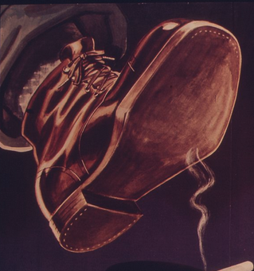
lh vs. l (example)
lhémexw
lémet
Image from Public domain images website, http://www.public-domain-image.com/full-image/nature-landscapes-public-domain-images-pictures/rain-public-domain-images-pictures/rain-droplets.jpg.html
National Archives at College Park, Public domain, via Wikimedia Commons
Notes:
Here are some examples. Lhemex, which means ‘raining’, starts with the hissy-l /ɬɬɬɬɬɬɬɬ/. We can compare this with /lemet, which means ‘to step on’, which starts with the regular /l.
Try saying them: lhemexw – lemet. Can you hear the difference? Can you feel how your tongue is the same, but your vocal folds are different?

Slide 5
Summarizing lh vs. l
lh is SIMILAR TO l in that:
But lh is DIFFERENT from l in that:
Tongue touches ridge
lh has no vibration at the vocal cords.
Air flows over the SIDES
lh sounds more ‘hissy’ (more noisy friction)
Notes:
[can just read the text, expand a bit, as you run through the fades]

Slide 6
Careful!
lh ≠ th
Notes:
It’s pretty easy to tell the difference between the hissy-l /ɬ/ and the regular-l /l/, but here’s something you should be careful to watch out for: many students mix up the hissy-l with the TH sound, which is pronounced /θ/.
This is a natural mistake, because /ɬ/ and /θ/ sound quite similar.

Slide 7
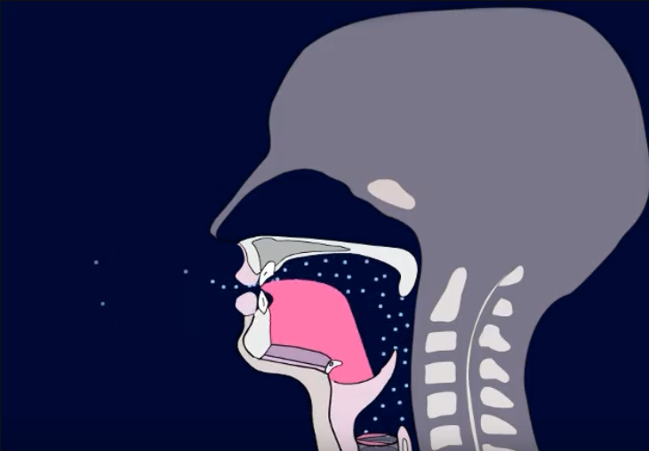
lh vs. th
lh
th
Tongue at ridge.
Tongue BETWEEN TEETH.
Notes:
The main difference between /ɬ/ and /θ/ is the position of the tip of your tongue. With the hissy-l /ɬ/, as you know, the tongue touches that ridge behind your teeth. With the /θ. Sound, the tip of your tongue is further FORWARD, and you have the tip of the tongue IN BETWEEN THE TEETH.
Otherwise the sounds are quite similar. There is no vibration in the throat with either of them, and both have heavy friction. That’s why many students can mix them up.
Try saying them, and see if you can feel the difference in where the tip of your tongue goes: hissy-l ɬɬɬɬɬɬ (ridge)., then the th-sound /θθθθθθθ/ (between teeth).

Slide 8
lh vs. th (example)
lhémexw
thélmet
Image from Public domain images website, http://www.public-domain-image.com/full-image/nature-landscapes-public-domain-images-pictures/rain-public-domain-images-pictures/rain-droplets.jpg.html
Kaibab National Forest, United States Forest Service, Public domain, via Wikimedia Commons
Notes:
Here is an example comparing the lh /ɬ/ with the th /θ/ lhlhllhlhemexw bebings with the hissy-l, and your tongue is touching the ridge. Thththelmet begins with the th-sound, and your tip of your tongue is further forward, between your teeth.

Slide 9
Summarizing lh vs. th
lh is SIMILAR TO th in that:
But lh is DIFFERENT from th in that:
They sound pretty similar
The tongue position is different
No vibration in throat
Lh touches ridge, but th has tip of tongue between teeth
Notes:
So to sum up: ɬ is the ‘hissy’ version of l.

Slide 10
Side note lh in other languages
In Hul’q’umi’num’ written lh (same)
In hən̓q̓əmin̓əm̓ written ɫ
In Secwepmectín written ll.
Linguistic IPA symbol is / ɬ /
Notes:
Let’s end this video with a side note about this same sound in other languages.
If you are interested in other languages, it may interest you to know that, though ɬ is not a significant sound in English, this same sound IS used in MANY other languages, though often with different spellings.
This sound is significant in most of the Salish languages. On the Island (Hul’q’umi’num’) it is written lh the same as in Halq’emeholem, but at Musqueam/Downriver areas, i.e. in hən̓q̓əmin̓əm̓, is is spelled with an l with a curvy line through it. In Secwepemectin (aka Shuswhap, spoken in the BC Interior) it is written with a double-l.
It also occurs in totally different languages in other parts of the world. For example in Welsh, which is one of the original languages of Britain (from before English), it is written like in Shushwap, with a double l.
In the linguistic IPA symbols, which you may sometimes see used in dictionaries etc., the official symbol is an l with a curving line through it.

